Slide 1

Secure Database
Dheeraj Kumar Sundar
Vinay Tahiliani
Yash Kajavadara

Slide 2
Introduction
As we are all aware, with cloud computing becoming the norm in the industry for flexible and ease of implementation for running and hosting applications for the obvious benefits of dynamic scaling and pay for what you use model, it has become increasingly difficult to protect data. It is impossible to protect the data from content scanning of these cloud providers to feed their business models. Not only privacy protection from the cloud providers, these cloud providers can also be a target of security breaches by malicious outsiders and the security is completely in the hands of the cloud provider. To overcome the above said issues we discuss our approach towards the problem and also show an implementation of the solution in Django.

Slide 3
Existing Problems and Solutions
Encryption-in-Transit: Data is encrypted during transmission to the cloud provider which protects the data against man-in-the-middle attacks. But the data received on the cloud storage is in plain-text form.
Encryption-at-rest: A widely provided feature by many databases is Transparent Data Encryption or TDE, encrypts data at rest.
Now, it may look like when used together this should solve the problem that we have but it does not and has two major drawbacks:
Data, though stored in encrypted form can still be inferred when loaded into the memory either by the cloud provider or by a malicious outsider.
Keys are at the same location as the encrypted data, one breach could uncover all the data stored.

Slide 4
Goals
Abstraction
Type handling, configuration
Being able to rotate keys
Even if third party gains access to db our data is protected.
Efficient query searching without any compromise on security and privacy
Authentication

Slide 5
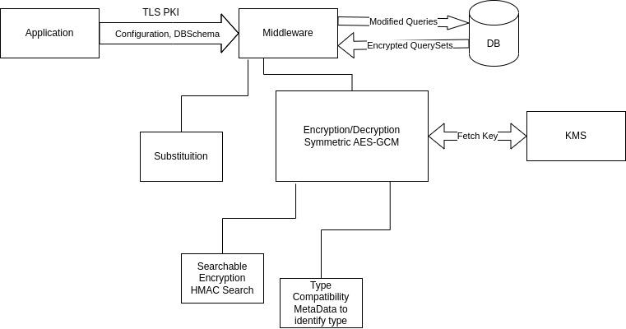
Our Solution

Slide 6
Components of Middleware - 1
Substitution: If configured for a column, the middleware substitutes the actual value with some randomized value, a small storage on the middleware maps this random value to the actual value. This strategy, though may leak information, can be used for attributes which fall on a lower scale of privacy protection. This strategy protects information to an extent and with the advantage of high performance when compared to encryption strategy.
Key Management Service: A Key management service will inject key into the environment variables of our middleware application.

Slide 7
Components of Middleware - 2
Encryption-Decryption: When configured for a column, the middleware encrypts the data and adds to the db along with some more meta-data. This metadata is useful for other components supported by the middleware, such as searchable encryption and type compatibility.
AES-GCM encryption strategy is used for the data encryption with nonce and tag appended to our final encryption block. This tag and nonce are recovered to verify and decrypt the data.
Searchable Encryption: To protect against the ciphertext attack we use AES-GCM which uses nonce to generate different cipher text for the same input, to be able to search the encrypted data we append keyed hash of the input to the encrypted data. This hash can be used to perform substr search (since nonce, tag, hash have fixed lengths and search for the hash) to fetch the appropriate data. But this comes with a limitation of being able to search with the exact value. This can be extended to perform a blind index search, essentially creating a hash(blind index) for every type of search query. For example, if name starts with Jon(saving hash of Jon and referencing this row to all the rows where name starts with Jon).
Type-Compatibility: To achieve true abstraction, middleware must handle typecasts, treat Big-int as Big-Int, varchar as varchar, etc. This means added extra data as metadata which indicates the type of the field that the application has set it to be.

Slide 8
Demo

